Slide 1
Data Warehousing for Urban Health
Ran Li, Alina Schnake-Mahl, Usama Bilal
UHC Weekly Forum
April 12, 2023

Slide 2
Overview
Introduction to data stewardship challenges (UB)
Overview of HCUP infrastructure
Data source: purchased HCUP data .asc
Extract-load: .asc to database
Transform: orchestrated by DBT
Summary
Q/A + Next steps
Notes:
First I want to start with an introduction of what we are trying to do. Importantly, to introduce some vocabulary so we can communicate effectively about rather abstract data stewardship concepts. This will involve introducing the big picture aka data pipeline then dialing in on some really critical details about datawarehouse design.
Secondly, give an overview of the current HCUP infrastructure which including the main processes: data source, extract-load, and transformation.

Slide 3
Overview
Intro of concepts
Data pipelines + big picture schematic
Datawarehouse design
Overview of HCUP infrastructure
Data source: purchased HCUP data .asc
Extract-load: .asc to database
Transform: orchestrated by DBT
Summary
Q/A + Next steps
Notes:
First I want to start with an introduction of what we are trying to do. Importantly, to introduce some vocabulary so we can communicate effectively about rather abstract data stewardship concepts. This will involve introducing the big picture aka data pipeline then dialing in on some really critical details about datawarehouse design.
Secondly, give an overview of the current HCUP infrastructure which including the main processes: data source, extract-load, and transformation.

Slide 4
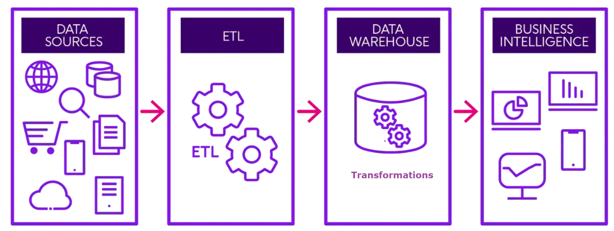
Intro: Big Picture
Data Pipeline is a sequence of operations/tasks. Data moves through these steps and a final output is produced.
Data Sources: diverse and unstructured
ETL stands for Extract Transform Load.
Data warehouse: centralized repository of data used for storing and transforming data. Key characteristics:
designed to support BI/research
Single integrated view of the organizations data
Single source of truth makes data easier to understand and use
Business Intelligence: are any downstream uses for data
Manuscripts
Dashboards
Web applications
Notes:
(go through each point)
Almost every data driven process can be captured by this schematic. Although the final product varying by field. For industry the BI could be a report that informs critical business decisions for academia it is often a manuscript. But it is true for everyone that the how your data pipeline is designed and executed will effect the timeliness, cost, quality and ultimately value of your final product.
Lets take a brief look at the big picture for HCUP.

Slide 5
Intro: Big Picture for HCUP
Purchased HCUP data
Read in .acs
Load to database
?
Manuscripts
Applications
Notes:
Data sources: Starting with Data Sources, we bought a bunch of data from HCUP. It is pretty clean and stored in .asc files.
ETL: ETL stands for Extract Transform Load. In many use cases we have to extract data/metadata from raw sources then clean it with some transformations before loading it into for use. In our case HCUP is pretty clean. So we just do the extract via the HCUP load scripts and then loading into our database which is just a bunch of .parquet files. This is relative straightforward.
Data Warehouse: This next step is kind of an unknown at the UHC. We sure do have data warehouses (everything that happens between data cleaning and manuscript analysis) but we don’t have a good conceptual understanding of what a data warehouse is or what best practices to follow an importantly lack of unity between groups when it comes to how to go from cleaned/structured data to research outputs.
There is definitely room for growth and value in building data warehousing capacity for us not only as at the project but also as a skill to incorporate into many projects. In general, tech companies leads trends for efficiency compared to academia and again this is the case for data warehouses. So designing infrastructure for HCUP, involved a lot of learning about how different companies build their data warehouses.
I before going into detail about the HCUP data pipeline. I want to just give a primer on data warehouses, importantly to clarify or introduce some vocabulary that is often confusing for those unfamiliar with data warhousing.

Slide 6

Database vs Data warehouse vs Data Lake
Typically when someone says `SQL` or `database` usually mean a relational database:
A database is just a collection of tables (columns, rows) that have relationship with each other.
OLTP database (online transactional process)
Designed for transactions (row-level read and write e.g. a new order from customer)
Good for live real-time transactional data (e.g. sales/commerce)
Usually represented by a stack icon (right).
Notes:
Here we are going to be looking at the differences between databases, data warehouses and data lake.
Lets start with a data base. Typically when someone says SQL or database they are referring to a data base (e.g. Oracle, MySQL, Postgres) they mean a relational database.

Slide 7
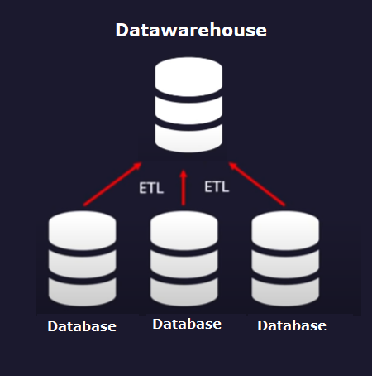
Database vs Data warehouse vs Data Lake
Data warehouse: is also a database but focused on analytics
A database with collection of tables (columns, rows) that have relationship with each other.
OLAP database (Online Analytical Process) database
Designed to analyze or process huge amounts of data
Has much better performance for analytics compared to database
Notes:
Here we are going to be looking at the differences between databases, data warehouses and data lake.
Lets start with a data base. Typically when someone says SQL or database they are referring to a data base (e.g. Oracle, MySQL, Postgres) they mean a relational database.

Slide 8
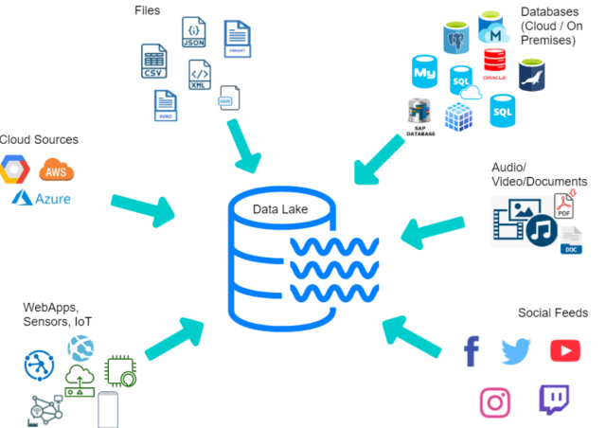
Database vs Data warehouse vs Data Lake
Data Lake:
OLTP/OLAP are designed to enable read/write/queries of structured data
Data lakes designed to capture less structured data (unstructured, semistructured, structured, video, image … ETC)
Mostly used for training ML/AI models
Notes:
Here we are going to be looking at the differences between databases, data warehouses and data lake.
Lets start with a data base. Typically when someone says SQL or database they are referring to a data base (e.g. Oracle, MySQL, Postgres) they mean a relational database.

Slide 9
Database vs Data warehouse vs Data Lake
Three different things for different purposes
Relational Database/OLTP for real time read/write of transactions
Datawarehouse/OLAP for analytics, reporting
Data lake for unstructured data
Takeaways
HCUP data is not transactional
HCUP data is structure
OLAP is best for us.
Notes:
Here we are going to be looking at the differences between databases, data warehouses and data lake.
Lets start with a data base. Typically when someone says SQL or database they are referring to a data base (e.g. Oracle, MySQL, Postgres) they mean a relational database.

Slide 10
Intro: Big Picture for HCUP
Purchased HCUP data
Read in .acs
Load to database
OLAP
Which one?
Manuscripts
Applications
Notes:
Data sources: Starting with Data Sources, we bought a bunch of data from HCUP. It is pretty clean and stored in .asc files.
ETL: ETL stands for Extract Transform Load. In many use cases we have to extract data/metadata from raw sources then clean it with some transformations before loading it into for use. In our case HCUP is pretty clean. So we just do the extract via the HCUP load scripts and then loading into our database which is just a bunch of .parquet files. This is relative straightforward.
Data Warehouse: This next step is kind of an unknown at the UHC. We sure do have data warehouses (everything that happens between data cleaning and manuscript analysis) but we don’t have a good conceptual understanding of what a data warehouse is or what best practices to follow an importantly lack of unity between groups when it comes to how to go from cleaned/structured data to research outputs.
There is definitely room for growth and value in building data warehousing capacity for us not only as at the project but also as a skill to incorporate into many projects. In general, tech companies leads trends for efficiency compared to academia and again this is the case for data warehouses. So designing infrastructure for HCUP, involved a lot of learning about how different companies build their data warehouses.
I before going into detail about the HCUP data pipeline. I want to just give a primer on data warehouses, importantly to clarify or introduce some vocabulary that is often confusing for those unfamiliar with data warhousing.

Slide 11
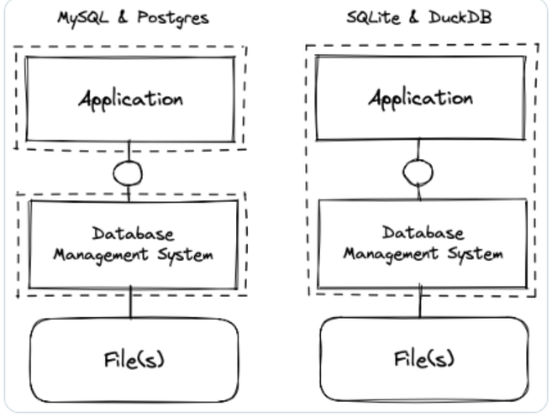
OLAP Databases Types: Server vs Serverless
Server-based
Serverless
Serverless
Native to whatever analytical programming you are working in (R, Python … ETC).
No infrastructure (e.g. local software, cloud server)
Enables out of memory operations on any computer
Files stored anywhere you want (local, UHC server, cloud… ETC)

Slide 12
Intro: Big Picture for HCUP
Purchased HCUP data
Read in .acs
Load to database
DuckDB
.parquet
DBT framework
Manuscripts
Applications
Notes:
Data sources: Starting with Data Sources, we bought a bunch of data from HCUP. It is pretty clean and stored in .asc files.
ETL: ETL stands for Extract Transform Load. In many use cases we have to extract data/metadata from raw sources then clean it with some transformations before loading it into for use. In our case HCUP is pretty clean. So we just do the extract via the HCUP load scripts and then loading into our database which is just a bunch of .parquet files. This is relative straightforward.
Data Warehouse: This next step is kind of an unknown at the UHC. We sure do have data warehouses (everything that happens between data cleaning and manuscript analysis) but we don’t have a good conceptual understanding of what a data warehouse is or what best practices to follow an importantly lack of unity between groups when it comes to how to go from cleaned/structured data to research outputs.
There is definitely room for growth and value in building data warehousing capacity for us not only as at the project but also as a skill to incorporate into many projects. In general, tech companies leads trends for efficiency compared to academia and again this is the case for data warehouses. So designing infrastructure for HCUP, involved a lot of learning about how different companies build their data warehouses.
I before going into detail about the HCUP data pipeline. I want to just give a primer on data warehouses, importantly to clarify or introduce some vocabulary that is often confusing for those unfamiliar with data warhousing.

Slide 13
Insert slide abourt parquet
Parquet is next generation CSV designed for analytics
Compression out of the box without zipping
Columnar storage
Data is stored in columns
Bypasses all storage size benefits of relational databases.
Denormalized data is easier for analytics.
Metadata built in (type casting, column names)
Integrates with OLAP serve as database files

Slide 14
Data Warehousing technical primer summary
https://db-engines.com/en/system/DuckDB%3BGoogle+BigQuery%3BPostgreSQL
Takeaway:
Utilize a serverless OLAP engine for our data warehouse
Utilize columnar file storage (.parquet) will increase performance and bypass all data storage limitations

Slide 15
Data warehousing best practices
OLAP engine and columnar storage will give us performance without any financial cost. Now what?
How do we organize our files
How do we split environments (dev vs prod vs… )
How do we ensure reproducibility
How do we store metadata about our tables
How do we validate data integrity
How do we organize our transformations?
How do we document all of the above?
How do we give end users access to our data
DBT is a complete solution for these common data warehousing problems. Learning DBT allows us to focus on our particular problem (the transformations and the data) and not about how to data warehouse.
Notes:
Now that we have

